Slide 1
the pilot project ‘AGIOS EFSTRATIOS-GREEN ISLAND’
Centre for Renewable Energy Sources and Saving (CRES)
Panagiotis Zorlos
Project Manager
EUROPEAN FORUM ON CLEAN FOR ISLANDS
Naxos, 9-11 July 2018

Slide 2
CRES
CENTER for RENEWABLE ENERGY SOURCES & SAVING (CRES)
Organization for RES, EE and Environment, founded in 1987
Public entity with administrative autonomy, supervised by Ministry for Energy
appointed as the national coordinator on RES/EE
CRES’ dual role
As the National Energy Centre
supports Government on RES, EE and Environment policy and planning
implements private investment programs funded by Greek Government, EC, EEA etc. as Managing Authority (e.g. two progressive National Programs on RES 1994-1999 & 2000-2009, total 850 M€)
As a Research and Technological Institution
Implements applied RI & Demo projects using own facilities and expertise
Elaborates market/development/dissemination/networking/clustering schemes, national and international
Collaborates with public entities and the private sector, participating and coordinating numerous National, European and & International funded projects

Slide 3
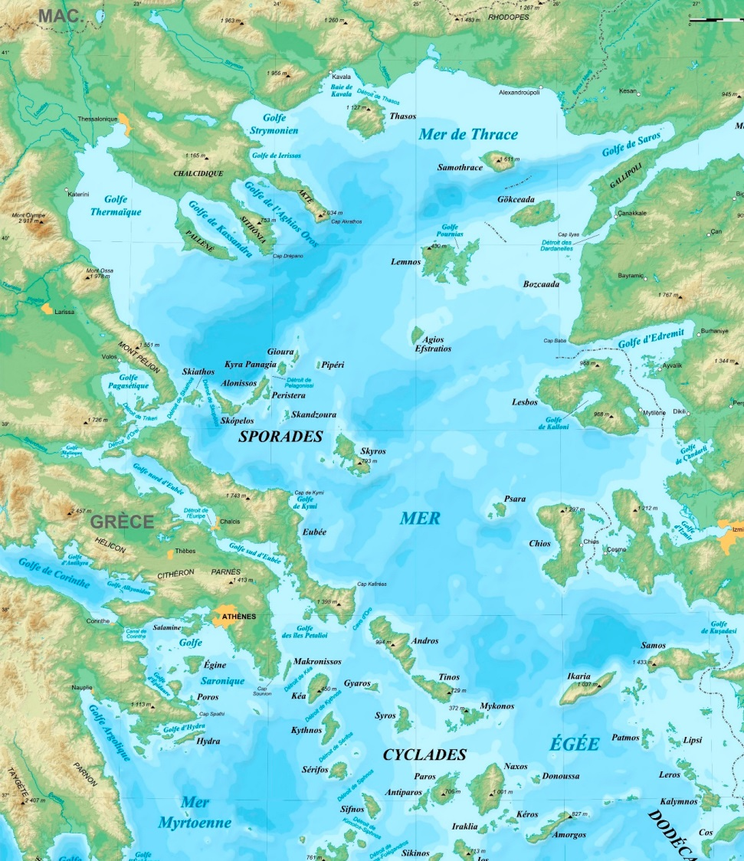
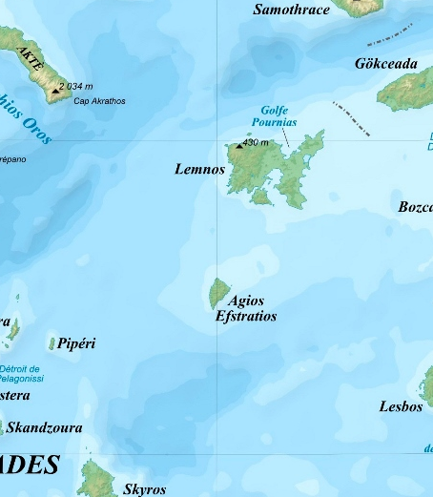
the Agios Efstratios Island
NORTH AEGEAN SEA
125 n. miles to Port Lavrio (Athens)
95 n. miles to Port Kavala (North)
NEAREST ISLAND: LEMNOS
16 n. miles coast to coast
20 n. miles port to port
NORTH AEGEAN SEA
125 n. miles to Port Lavrio (Athens)
95 n. miles to Port Kavala (North)

Slide 4
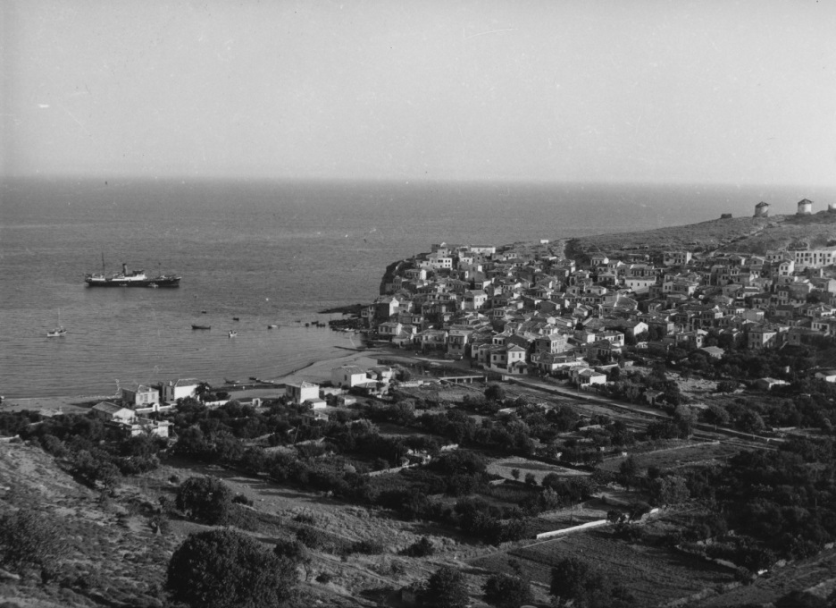
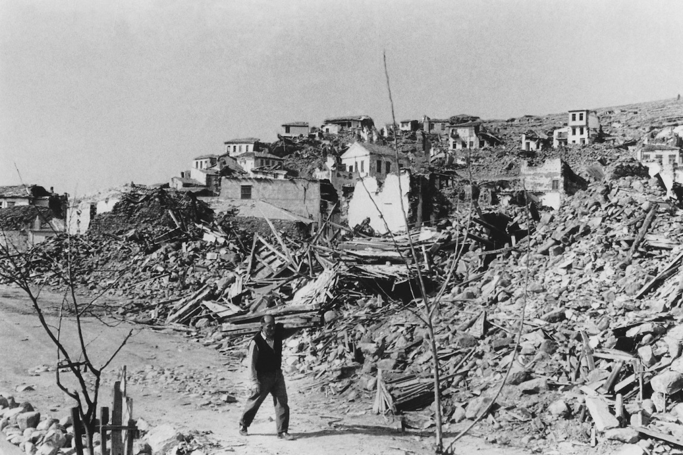
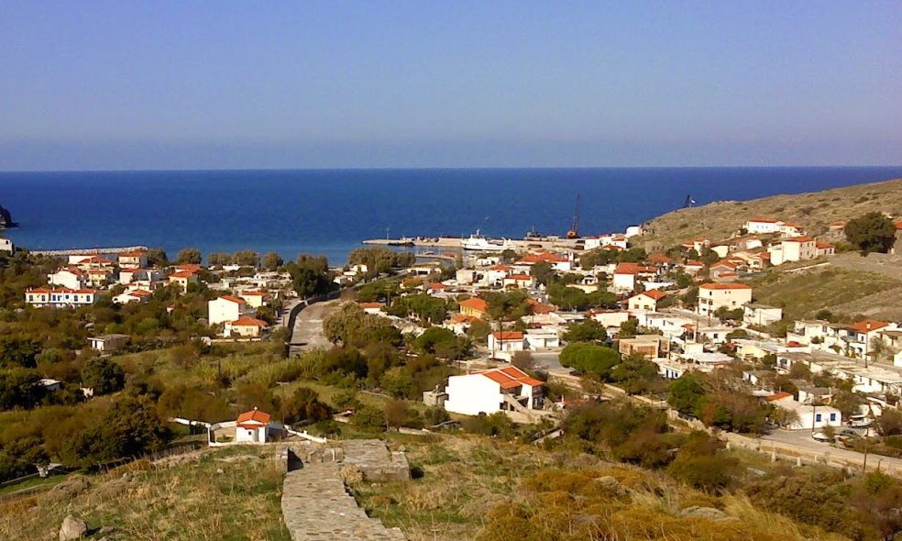
RECENT HISTORY
Destructive earthquake hit in 1968
20 people died
New settlement was built nearby the old village
The island’s image changed dramatically

Slide 5

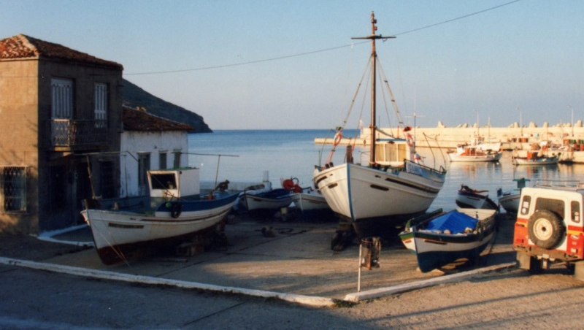
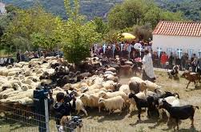
local economy
Population 200 inhabitants
Partially depended on imported daily goods from the adjacent Limnos Isl.,
Fishery (class fishes and lobsters), facilitated by local fishing cooperative
Livestock (mainly sheep breeding), milk products (cheese)
Tourism (summer visitors)
Primary/high school, health center, police and port authorities, post services
Municipal Authority

Slide 6
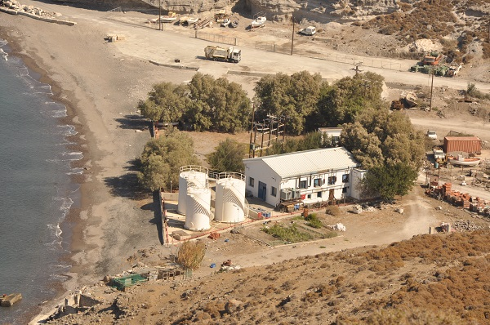
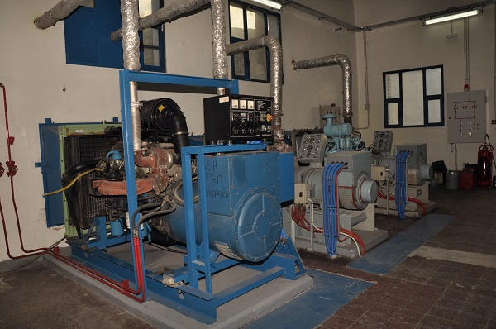
energy demand
ELECTRICITY served by local Diesel Power Station
2X90 + 3X220 = 840 kW
1,2 GWh/y
HEATING served mainly by domestic fuel boilers, est 0,8 GWh/y
INLAND TRANSPORT

Slide 7
background
The concept
Make an isolated and non interconnected island (NII) as green as possible, concerning its energy consumption
Deploy a wide range of mature Renewable Energy Sources (RES) technologies
Initiate an innovative power producer scheme, deploying and motivating local communities
Targets
Very high RES penetration (>85%) in the electricity system of the island Agios Efstratios, 1,2 GWh/y and 350 kW peak load
Upgrading the energy efficiency of all municipal buildings
Demonstration of RES charged electrical vehicles
Additional targets
Reduction the share of curtailed RES energy
Reduction of oil based heating by >75%
Reduction of heating cost by 50%
Yearly reduction of GHG equal to 1,25 kt CO2_{eq}

Slide 8
project overview
Project Title ‘Agios Efstratios-Green Island’ pilot project (2nd phase)
Beneficiary Municipality of Agios Efstratios
Implementation CRES
Funding European Regional Development Fund (ERDF)
Program Operational Program COMPETITIVENESS, ENTERPRENEURSHIP and INNOVATION
Frame Program National Strategic Reference Framework 2014-2020 (NSRF-ESPA)
Budget: 8,5 M€, VAT incl.
Start : 2nd Q 2017
Duration 5 y, incl. Monitoring and Evaluation
End 2nd Q 2022

Slide 9
PROJECT LAYOUT
MAIN ACTIONS
RES BASED COMBINED ELECTRICITY/HEATING SYSTEM (core action)
TARGET ACTIONS on EE and ENERGY SAVING in BUILDINGS and TRANSPORT
SUPPORT ACTIONS
PREPARATORY WORKS and MANAGEMENT (incl. subcontracting)
MEASUREMENTS, MONITORING and EVALUATION
DISSEMINATION
ESTABLISHMENT OF THE NEW POWER PRODUCER

Slide 10
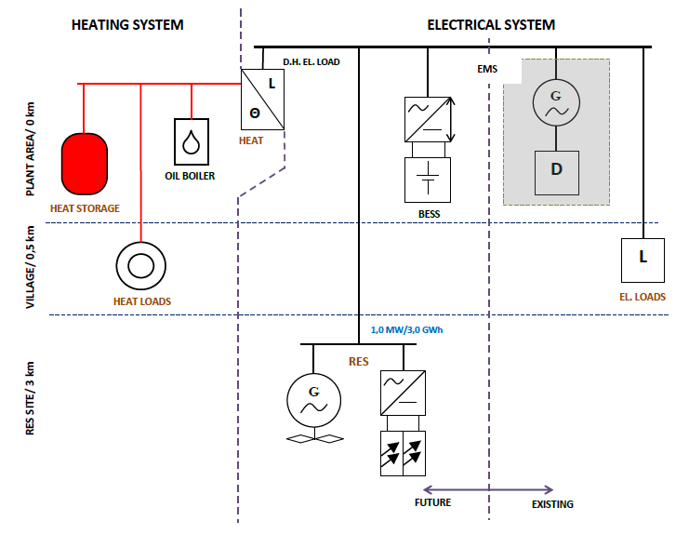
RES BASED HYBRID ENERGY SYSTEM
RES Hybrid System
1,0 MW RES power plant, WT 800-900 kW, PV 150-250 kW.
BESS 1 MW/2,5 MWh
EMS
Grid interconnection infrastructure
District Heating (D.H.)
D.H. plant (electricity-to-heat units + back up thermal unit, 800 kW each)
500 m3 insulated hot water storage tanks (30 MWh at ΔT=55º C)
4 km distribution network and consumer substations
EMS

Slide 11
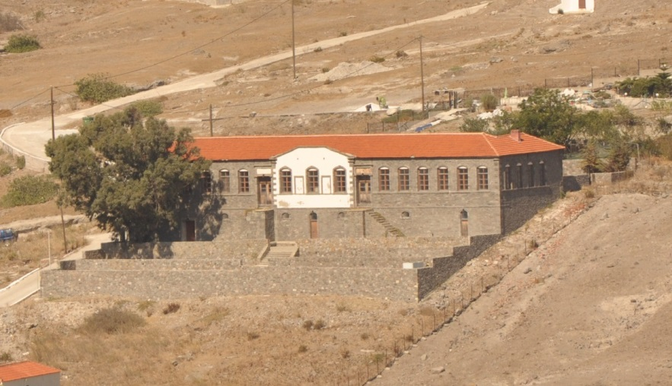
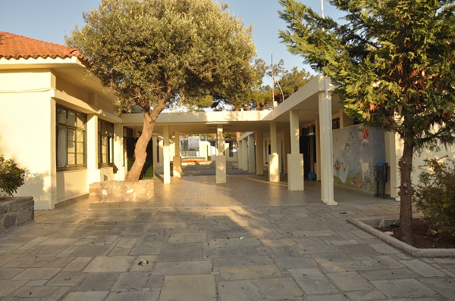
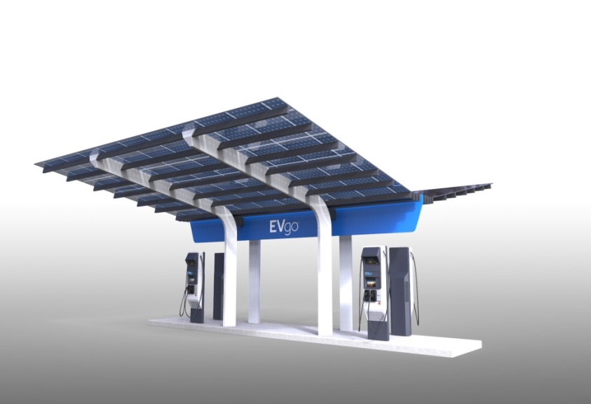
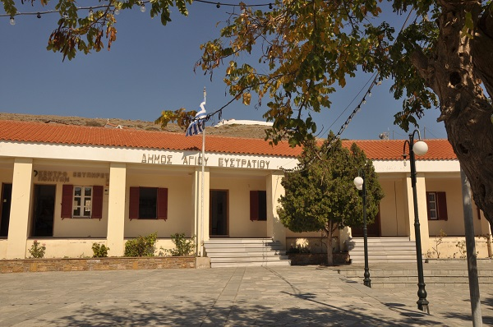
ENERGY SAVING ACTIONS
Thermal insulation of municipal buildings and school complex
Introduction of RES charged electrical vehicles

Slide 12
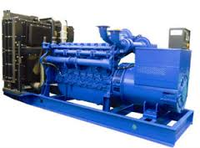
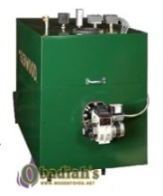
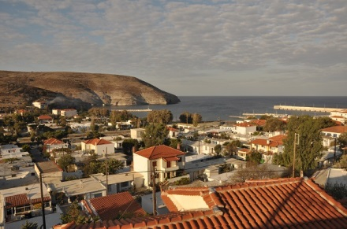
energy demand
No RES
Electricity: 1,2 GWh/y 350 kW peak
served by local diesel station (PPC)
2X90+3X220=840 kW
Domestic central heating units, 800 MWh/y
850 kW peak
100%
100%
100%
Central heating

Slide 13
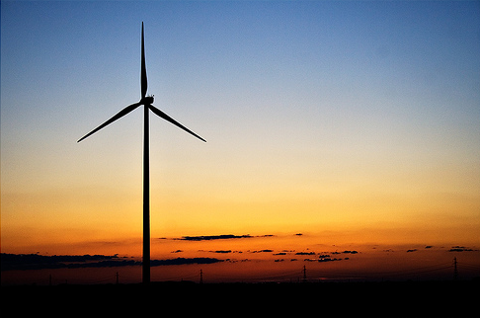

INTRODUCTION of RES
1,0 MW RES
~3 GWh/y
Diesel Station
~2 GWh
0,2 GWh
<15%
1 GWh
>85%
100%
100%
Central heating

Slide 14
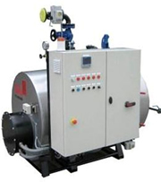
INTRODUCTION of RES + D.H.
1,0 MW RES
~3 GWh/y
Diesel Station
~1 GWh
0,2 GWh
<15%
~1 GWh
1 GWh
>85%
RES 80%
District Heating
0%
FUEL 20%

Slide 15
fault
1,0 MW RES
0 GWh/y
Diesel Station
100%
RES ?%
100%
District Heating
FUEL ?%

Slide 16
security
1,0 MW RES
0 GWh/y
Diesel Station
1,2 GWh
100%
RES 0%
100%
central heating
FUEL 0%

Slide 17
progress
Up to now
Project particularities adopted by law (L. 4495/2027, art. 152)
External expertise on hybrid systems and district heating completed
Integrated energy simulation carried out by the NTUA, basic components have been dimensioned
Simplified energy management procedures have been proposed, slightly deviated from the existing grid code for NII
Close collaboration with the authorities concerned (Ministry for Energy, RAE, Operator of NII, PPC)
Land use secured, the environmental licensing is ongoing
Next crucial steps
Institutional decisions to regulate the operational principles and energy pricing are expected
Preparation of bidding documents (technical specifications the main components)

Slide 18
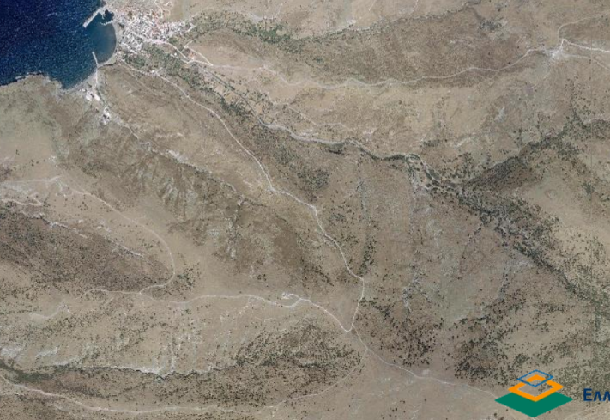
PROJECT SITES
SETTLEMENT
ΟΙΚΙΣΜΟΣ
D.S.-BESS-D.H
15 kV POWER LINE
RES SITE

Slide 19
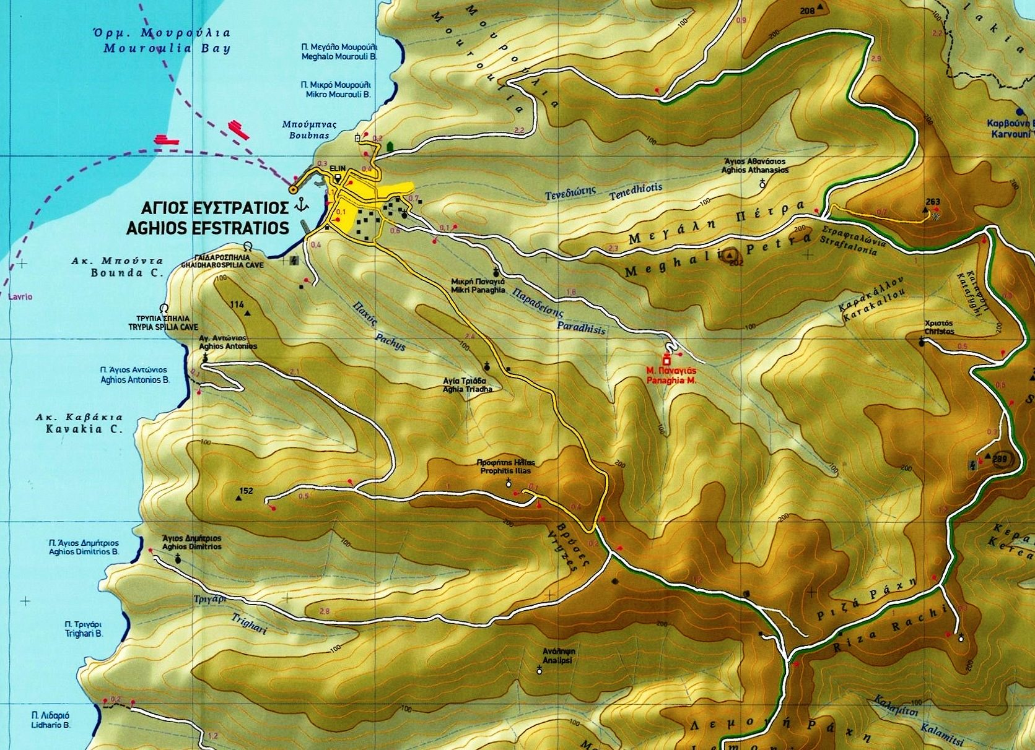
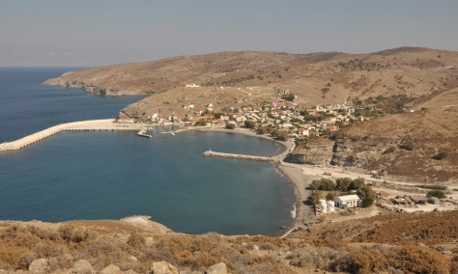
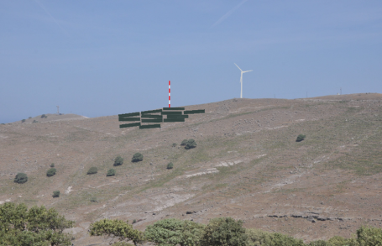
PROJECT SITES
SETTLEMENT
D.S.-BESS-D.H.
RES SITE

Slide 20

PROJECT SITES
Old Village
3 km to RES site
New settlement
Port
Diesel station (PPC)
BESS-EMS-D.H.

Slide 21
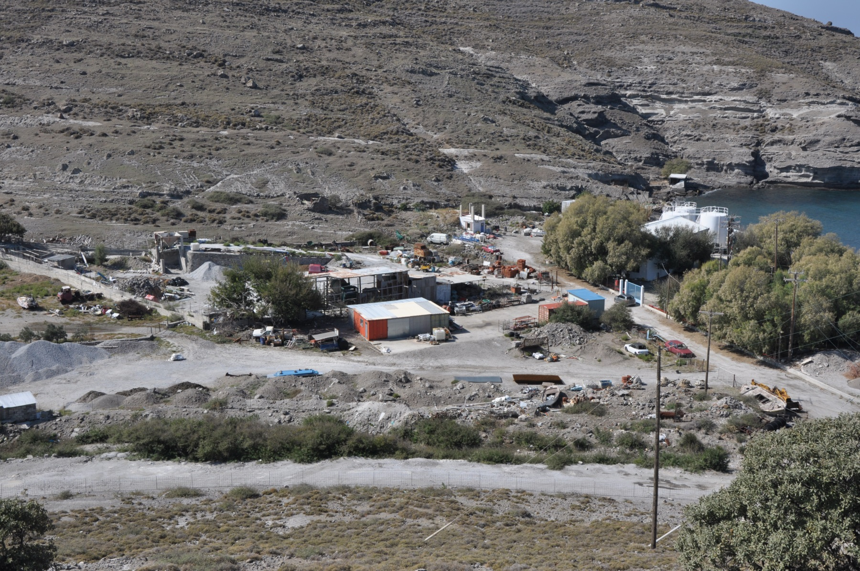
plant area

Slide 22
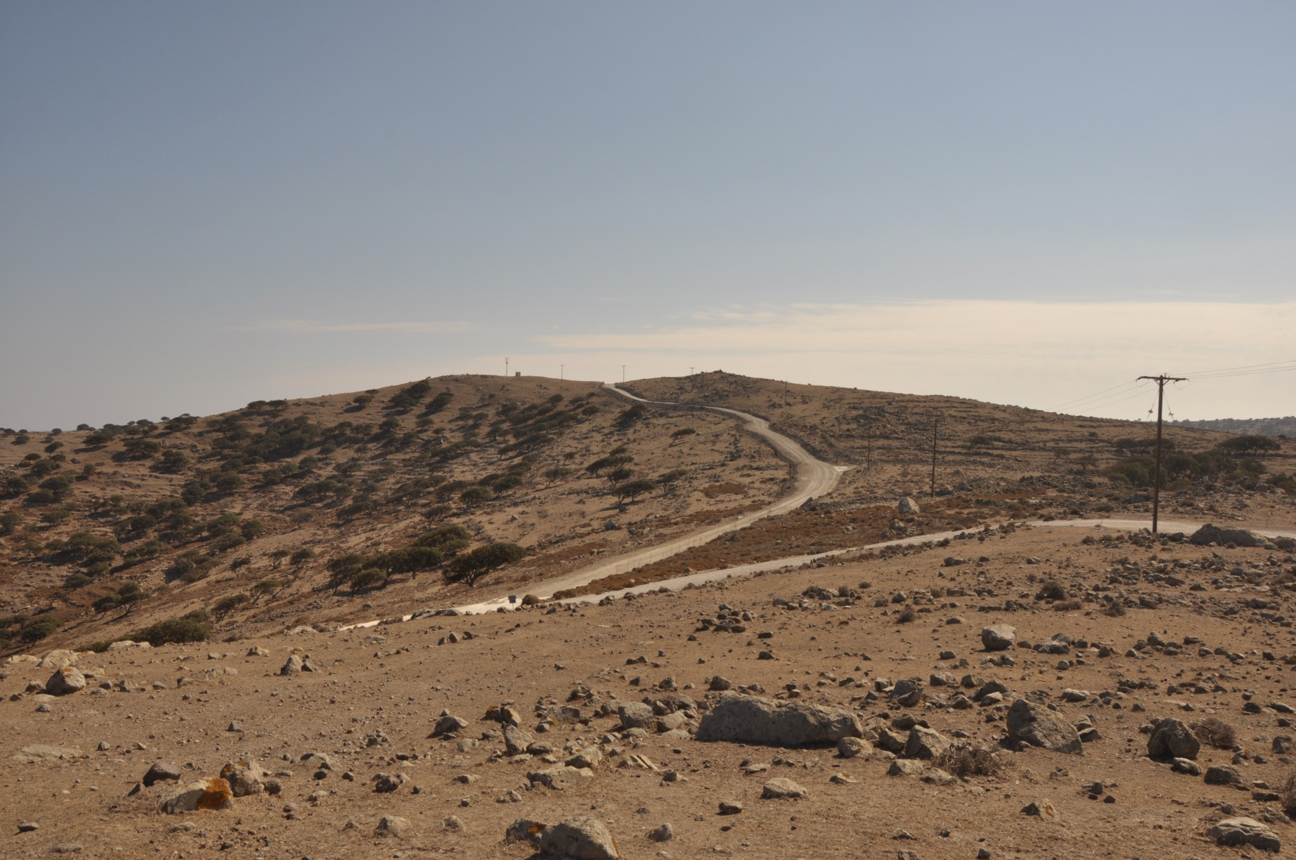
RES SITING
(W/T)
W/T
METEO
PV

Slide 23
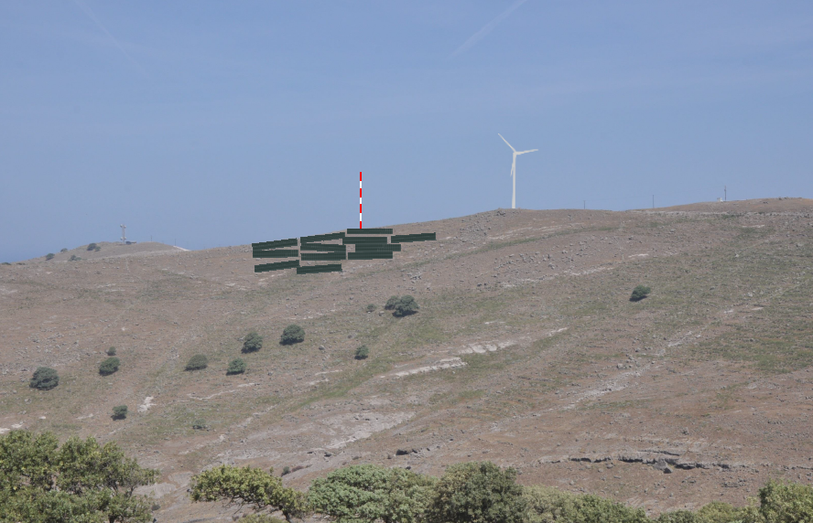
THANK YOU FOR YOUR ATTENTION

